Slide 1



AngularJS services

Slide 2
Services
Controllers
Services
For memory and performance purposes, controllers are instantiated only when they are needed and discarded when they are not. That means that every time we switch a route or reload a view, the current controller gets cleaned up by Angular.
Services provide a method for us to keep data around for the lifetime of the app and communicate across controllers in a consistent manner.

Slide 3
Services
Registering a Service
Using Services
var app = angular.module("MyApp", []);
app.factory("UserService", function() {
var users = ["Peter", "Daniel", "Nina"];
return {
all : function() {
return users;
},
first : function() {
return users[0];
}
};
});
app.controller("MyCtrl", function($scope, UserService) {
$scope.users = UserService.all();
});
app.controller("AnotherCtrl", function($scope, UserService) {
$scope.firstUser = UserService.first();
});
<html>
<head>
<script src="js/angular.js"></script>
<script src="js/app.js"></script>
<link rel="stylesheet" href="css/bootstrap.css">
</head>
<body ng-app="MyApp">
<div ng-controller="MyCtrl">
<ul ng-repeat="user in users">
<li>
{{user}}
</li>
</ul>
<div class="nested" ng-controller="AnotherCtrl">
First user: {{firstUser}}
</div>
</div>
</body>
</html>

Slide 4
Dependency injection

Slide 5
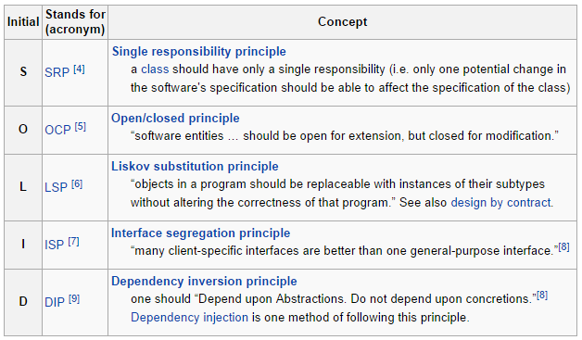
Dependency injection
In traditional software development, lower-level code was consumed by higher-level components to create more complex systems. This resulted in a close coupling of the different levels of code.
By depending on the different levels on abstractions, this coupling has been largely reduced and code can be maintained and reused in an easier way.

Slide 6
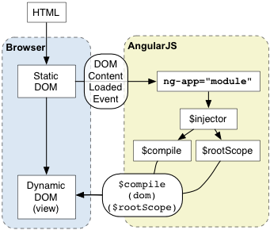
Dependency injection
<!doctype html>
<html ng-app>
<head>
<script src="http://code.angularjs.org/angular-1.0.2.min.js"></script>
</head>
<body>
<p ng-init=" name='World' ">
Hello {{name}}!
</p>
</body>
</html>

Slide 7
Dependency injection
Browser loads the HTML and parses it into a DOM
Browser loads angular.js script
Angular waits for DOMContentLoaded event
Angular looks for ng-app directive, which designates application boundary
Module specified in ng-app (if any) is used to configure the $injector
$injector is used to create the $compile service as well as $rootScope
$compile service is used to compile the DOM and link it with $rootScope
ng-init directive assigns World to the nameproperty on the scope
The {{name}} interpolates the expression to Hello World!
<!doctype html>
<html ng-app>
<head>
<script src="http://code.angularjs.org/angular-1.0.2.min.js"></script>
</head>
<body>
<p ng-init=" name='World' ">
Hello {{name}}!
</p>
</body>
</html>

Slide 8
Injection order

Slide 9

Services
As a naming convention, Angular's built-in services, Scope methods and a few other Angular APIs have a $ prefix in front of the name.

